Slide 1
Decision Tree
Omar Essam

Slide 2
Content
Agenda
1 | What is decision tree & Components of decision tree
2 | How a Tree "Learns": The Splitting Process
3 | Recursive partitioning explain
4 | kind of decision tree
5 | Rafael Nadal data set
6 | code

Slide 3
01
What is decision tree

Slide 4
What is decision tree
a flowchart or a game of "20 Questions.”
It's a type of machine learning algorithm that builds a model by learning simple if-then-else rules from a dataset. Its main job is to take a set of inputs and predict a category (or "class"), such as "Yes/No," "Spam/Not Spam," or "Cat/Dog/Fish."

Slide 5
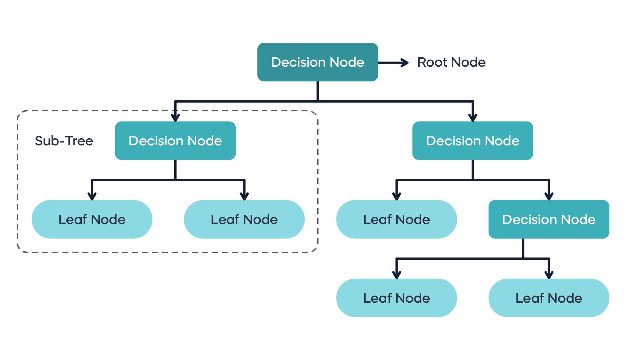
Decision tree has three main types of nodes
Root Node: This is the very top of the tree. It represents the entire dataset and is the first "question" the tree asks to start splitting the data.
Internal Nodes (Decision Nodes): These are the nodes in the middle of the tree. Each one represents a "question" (a test on a specific feature, like "Is Age > 30?"). This node splits the data into two or more sub-groups based on the answer.
Leaf Nodes (Terminal Nodes): These are the nodes at the very bottom of the tree. They don't ask any more questions. Instead, they represent the final decision or classification (e.g., "Clicked Ad" or "Did Not Click Ad").

Slide 6
02
How a Tree "Learns": The Splitting Process

Slide 7
How a Tree "Learns": The Splitting Process
A decision tree is built using a process called recursive partitioning. The main goal is to ask the "best" questions first—the ones that do the best job of splitting the data into "pure" groups.
Here's the step-by-step learning process:
Start at the Root: The algorithm looks at the entire dataset.
Find the Best Split: It tests every feature (like Age, Income, Is Student?) to find the one question (the best split) that will divide the data into the purest possible child nodes.
The "Equation" (Measuring Purity): How does it know what the "best" split is? It uses a mathematical formula to measure impurity. The most common formula is the Gini Impurity.
Make the Split: The algorithm chooses the feature and threshold (e.g., Age > 30) that results in the lowest weighted Gini Impurity for the two new child nodes. This is also called maximizing "Gini Gain."
Repeat (Recurse): The algorithm now treats each of these child nodes as a new "root node" for the data that fell into it. It repeats steps 2-4, finding the next best question to ask.
Stop: This process stops when:
A node is 100% pure (all members are in one class).
The tree reaches a maximum depth set by the user (to prevent it from getting too complex).
A split doesn't add any significant value.

Slide 8
03
Recursive partitioning

Slide 9
explanation
Recursive partitioning is the "engine" that builds a decision tree. Think of it as an automated "divide and conquer" strategy for sorting a messy pile of data.
The Goal: To create a flowchart of questions that splits your mixed-up data into the "purest" possible groups. A "pure" group is one where all the items belong to the same class (e.g., 100% "Yes").
Start at the Root: The algorithm begins with the entire, unsorted dataset in a single node.
You have one giant box with 100 mixed red and blue marbles
2. Find the "Best Split": It searches every single feature (e.g., Age, Income) and every possible threshold (e.g., Age < 30?) to find the one question that does the best job of splitting the data into purer groups.
"Best" is measured using a formula like Gini Impurity or Entropy. The split with the biggest drop in impurity wins.
You check all possible labels: "Is it heavy?" "Is it small?" "Is it striped?" You find the best question is, "Is the marble blue?
3. Partition (Split): The algorithm creates two new branches (e.g., a "True" branch and a "False" branch). The data is divided and sent to these new "child nodes.“
You create two new, smaller boxes. All blue marbles go in one, and all red marbles go in the other.
4. Recurse (Repeat): This is the key. The algorithm now treats each child node as a new, smaller starting point and repeats the whole process from Step 2.
You move to the "Red" box (which might still have "striped red" and "solid red" marbles). You ask, "Okay, for this box, what's the next best question?" You find it's "Is the marble striped?" and you split that box again.
5. Stop (Create Leaf Nodes): This process doesn't go on forever. It stops on a branch when one of these conditions is met:
Perfect Purity: The node is 100% pure (e.g., the box only contains "solid red marbles"). There's no need to ask more questions.
No Improvement: No available question can be found that will make the groups significantly purer.

Slide 10
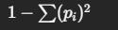
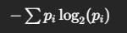
Gini & Entropy
Name | Gini Impurity. (cart) | Entropy
Def | measure the same thing: how "messy" or "impure" a set of data is. | measure the same thing: how "messy" or "impure" a set of data is.
Nickname | "Misclassification" Metric | "Surprise" Metric
Explanation | measures the likelihood of incorrectly classifying a new, random item if you assigned it a label based on the distribution of classes in that node | information theory and measures the amount of disorder, uncertainty Scale: 0 to 1.0 (for a two-class problem). 0 = Perfect Order: (All data is one class). There is zero surprise. You know exactly what you're going to get. 1.0 = Maximum Disorder: (A 50/50 split). This is maximum uncertainty. You are maximally surprised by the outcome because it's a perfect coin flip.
Example | A Basket of Fruit 🧺 Imagine you have a basket of 10 fruits. Case 1 (Pure): 10 apples 🍎. The Gini Impurity is 0. If you randomly pick a fruit, you know it's an apple. Case 2 (Impure): 5 apples 🍎 and 5 oranges 🍊. The Gini Impurity is 0.5. This is maximum chaos. If you randomly pick a fruit, you have a 50% chance of guessing wrong. | The Same Fruit Basket 🧺 Case 1 (Pure): 10 apples 🍎. The Entropy is 0. There is no uncertainty or surprise. Case 2 (Impure): 5 apples 🍎 and 5 oranges 🍊. The Entropy is 1.0. This is maximum disorder and surprise.

Slide 11
Gini & Entropy
Name | Gini Impurity. (cart) | Entropy
Sol | Case 3 (Better): 8 apples 🍎 and 2 oranges 🍊. The Gini Impurity is 0.32. It's still impure, but much "cleaner" than Case 2 | Case 3 (Better): 8 apples 🍎 and 2 oranges 🍊. The Entropy is 0.72. There is some disorder, but much less than in Case 2.
What it measures | Probability of misclassification | Amount of disorder/uncertainty
Computation | Faster. It only involves squaring | Slightly slower. It involves a logarithm.
Result | Tends to favor larger partitions. | Tends to create slightly more balanced trees.

Slide 12
When the Algorithm Uses It
Let's say the algorithm is trying to split this data:
Node 4: {🍎, 🍎, 🍎, 🍎, 🍎, 🍎, 🍊, 🍊} (6 Apples, 2 Oranges)
The algorithm wants to find a split. It tests two options:
Option A: Split by "Color = Red"
Child 1 (Red): {🍎, 🍎, 🍎, 🍎, 🍎, 🍎, 🍊} (6 Apples, 1 Orange)
Child 2 (Not Red): {🍊} (0 Apples, 1 Orange)
Option B: Split by "Size = Big"
Child 1 (Big): {🍎, 🍎, 🍎, 🍊, 🍊} (3 Apples, 2 Oranges)
Child 2 (Small): {🍎, 🍎, 🍎} (3 Apples, 0 Oranges)
To decide between Option A and Option B, the algorithm will:
Calculate the impurity (either Gini or Entropy) of Child 1 and Child 2 for Option A.
Calculate the impurity of Child 1 and Child 2 for Option B.
Compare the results. It will pick the option (A or B) that results in the lowest weighted average impurity. This is the "best split."

Slide 13
04
kind of decision tree

Slide 14
explanation
There are two main kinds of decision trees, based on what type of value they are trying to predict.
1. Classification Trees
This is the type you just asked about. Its goal is to predict a discrete category or class.
Output: A class label (e.g., "Yes," "No," "Spam," "Not Spam," "Cat," "Dog").
How it Works: It splits the data based on questions that best separate the classes. The final "answer" in a leaf node is determined by a majority vote.
Example: If a leaf node contains 8 samples that are "Spam" and 2 samples that are "Not Spam," the tree will predict "Spam" for any new data point that lands in that leaf.
2. Regression Trees
This type is used when your goal is to predict a continuous numerical value.
Output: A number (e.g., $150,000, 75.3 degrees, 4.5 years).
How it Works: It splits the data based on questions that minimize the variance of the numbers in the resulting groups. The final "answer" in a leaf node is the average (or mean) of all the training samples that landed there.
Example: You want to predict a house price. A leaf node might end up with 3 houses from your training data.
House 1 Price: $200,000
House 2 Price: $210,000
House 3 Price: $190,000
The tree's prediction for any new house that lands in this leaf will be the average: $200,000.

Slide 15
05
Rafael Nadal data set

Slide 16
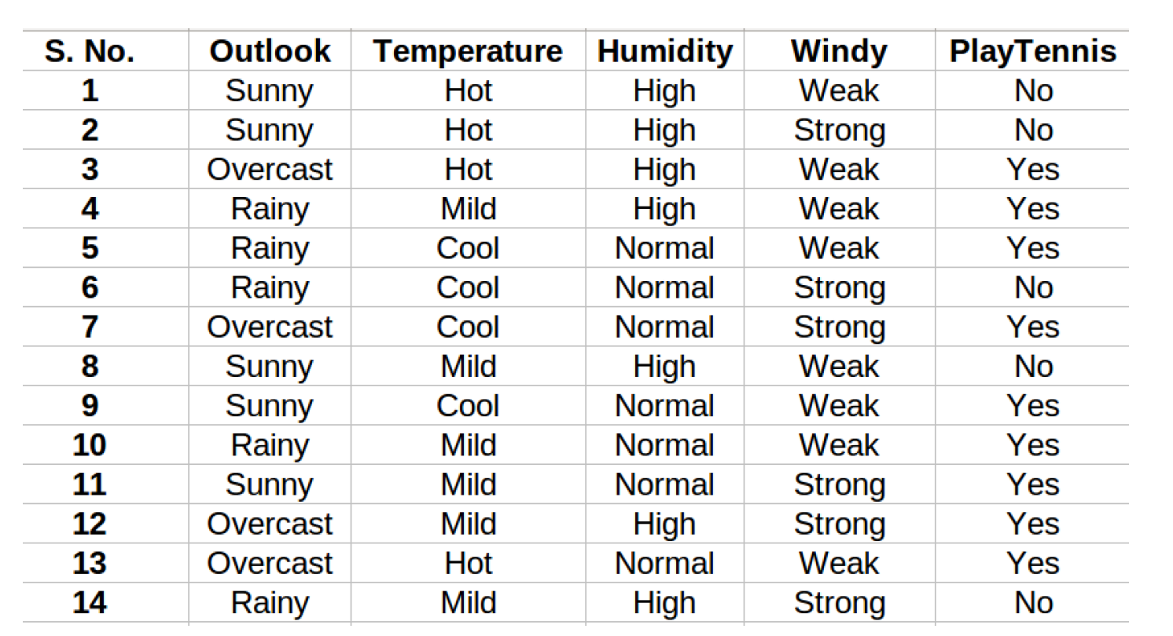
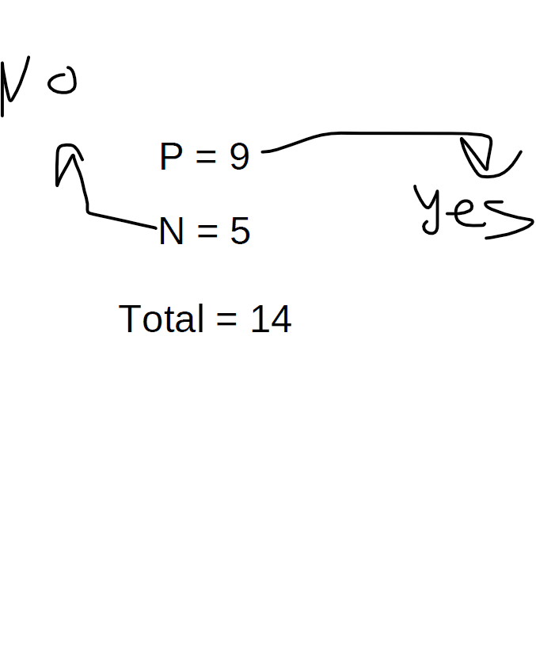
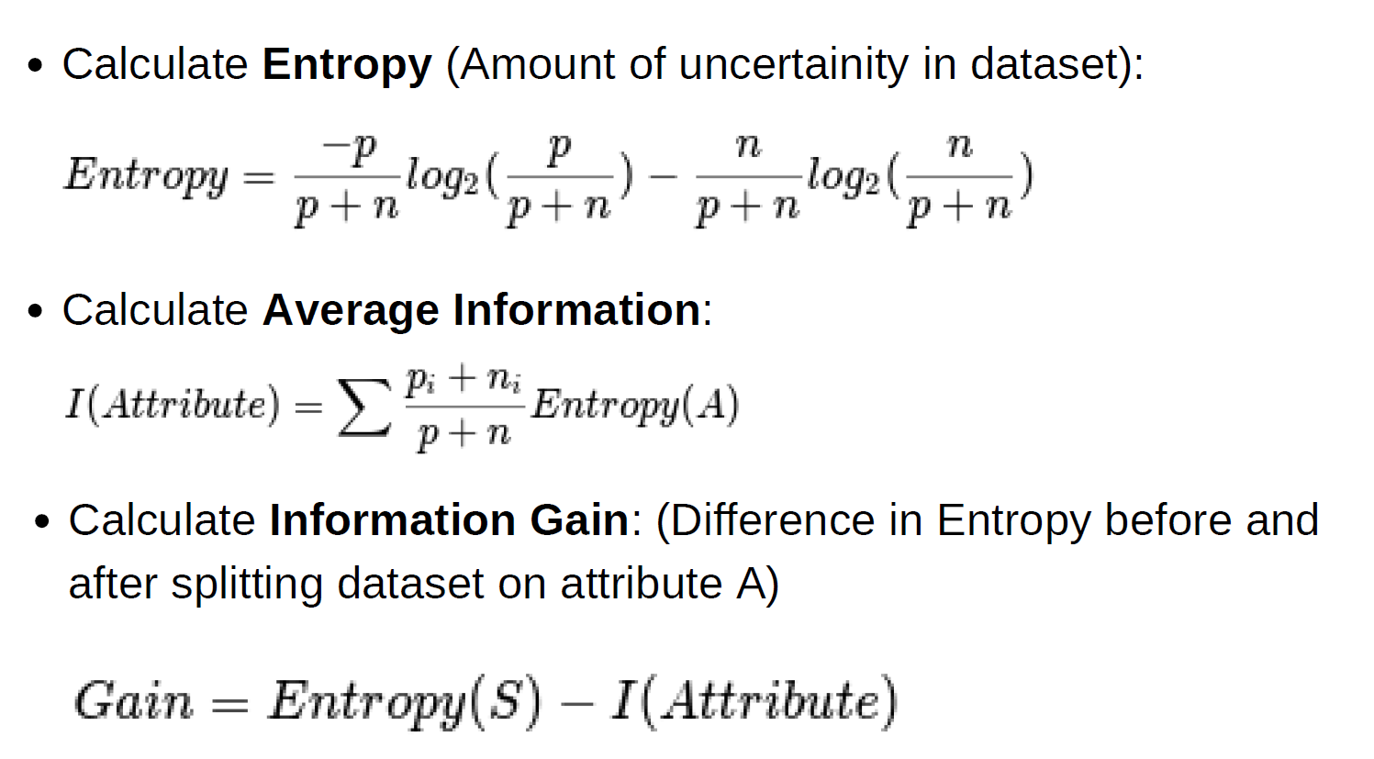
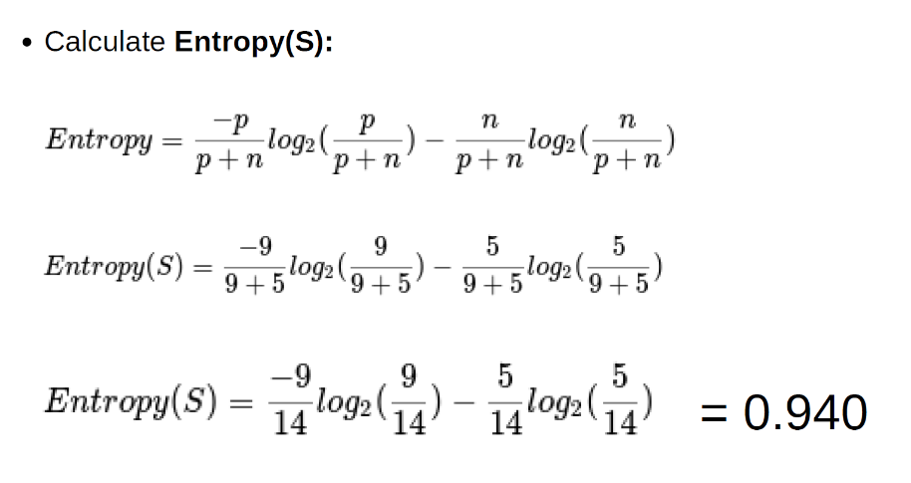

Slide 17
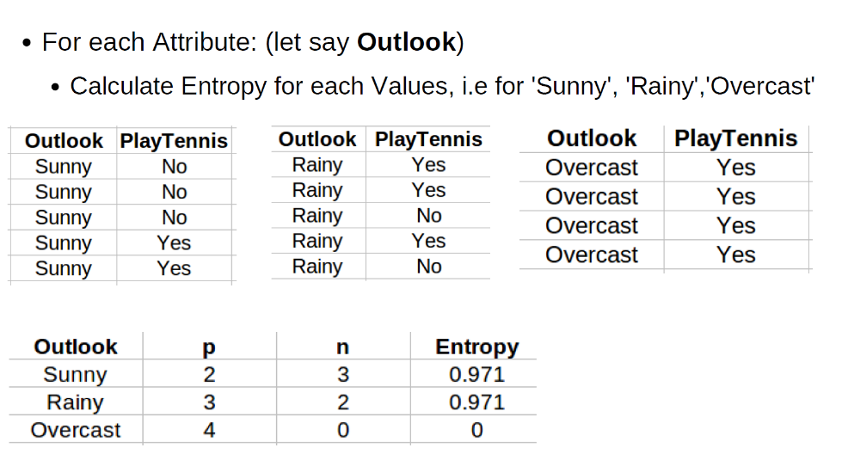
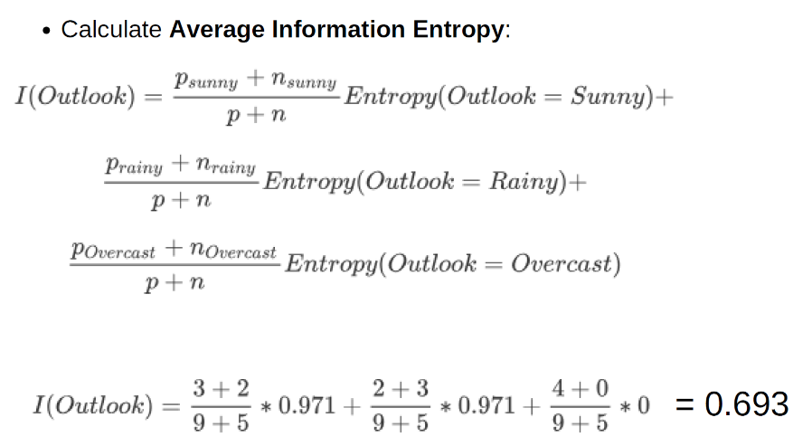
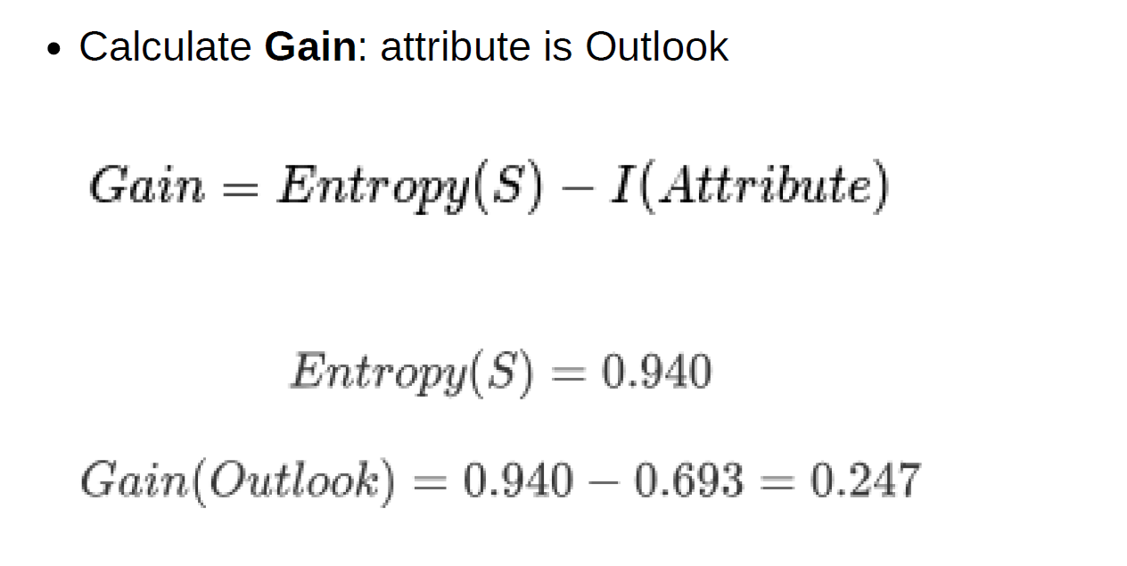

Slide 18
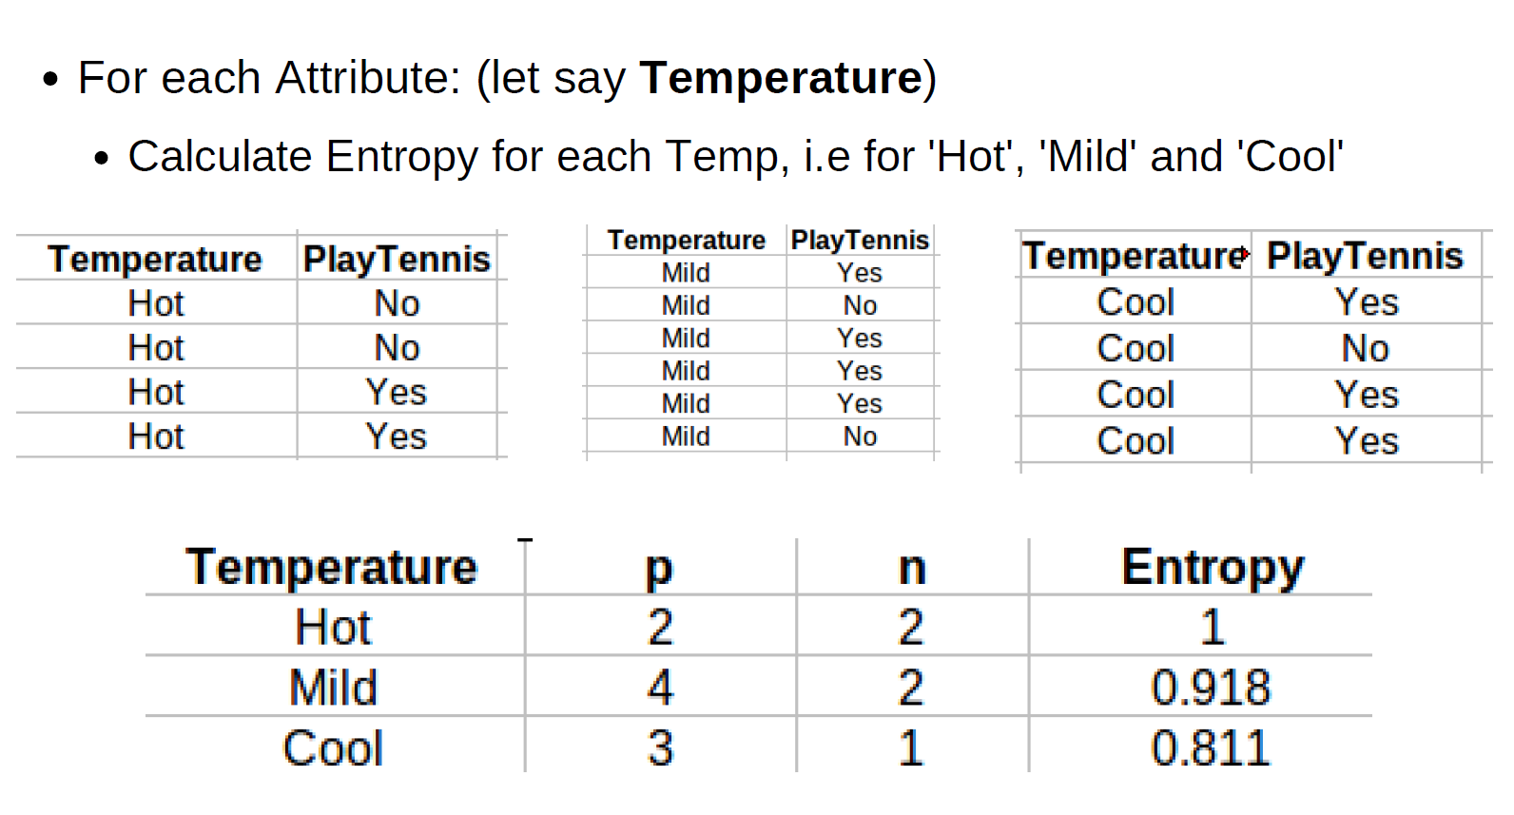
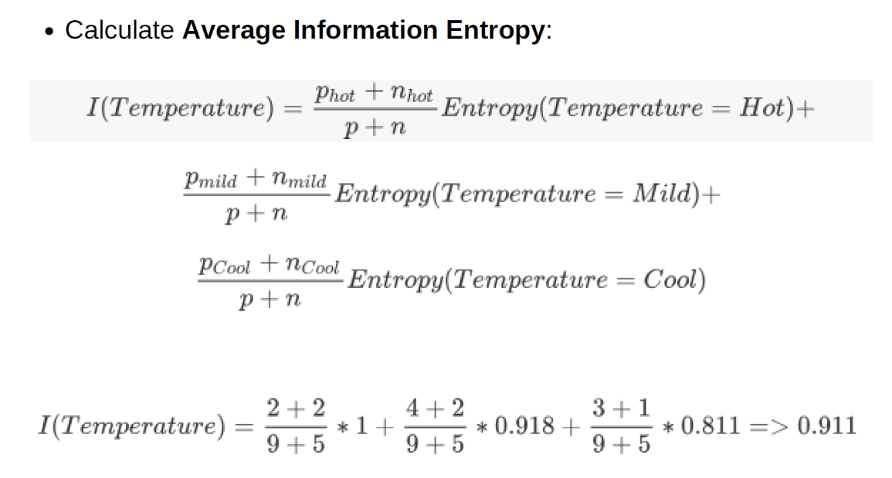
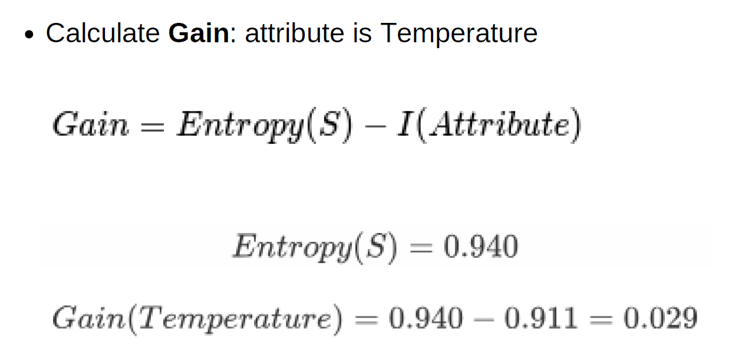

Slide 19
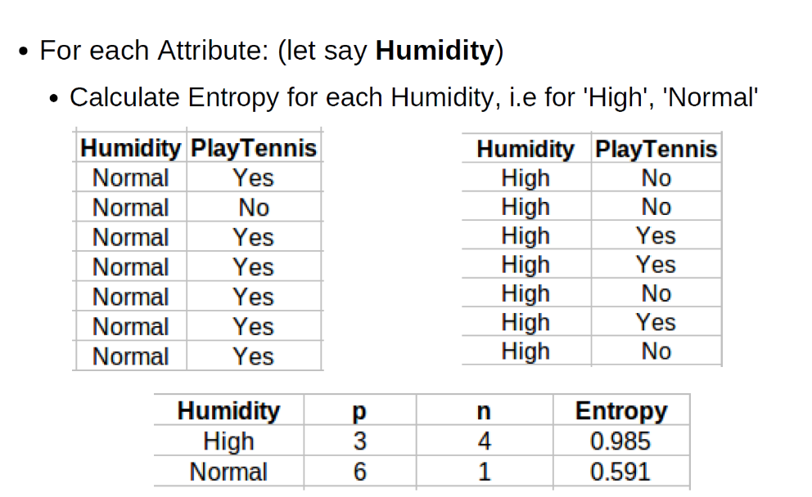
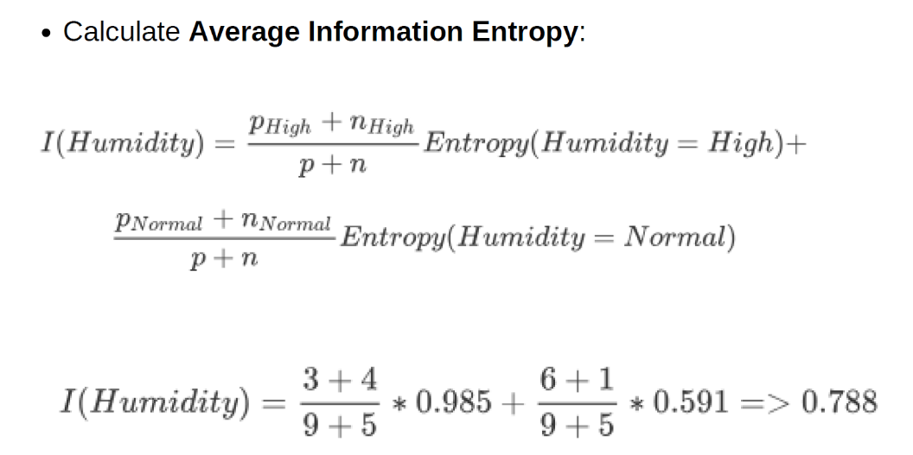
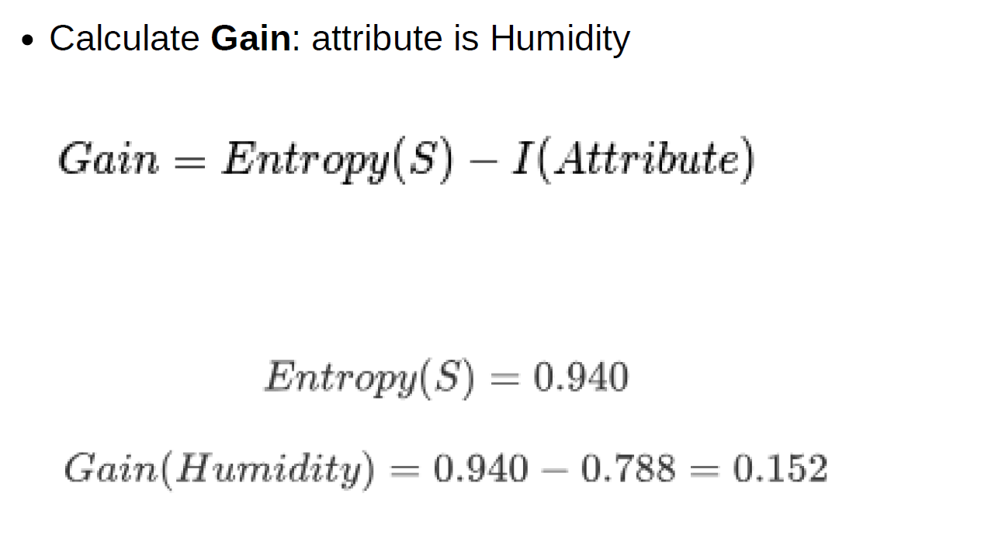

Slide 20
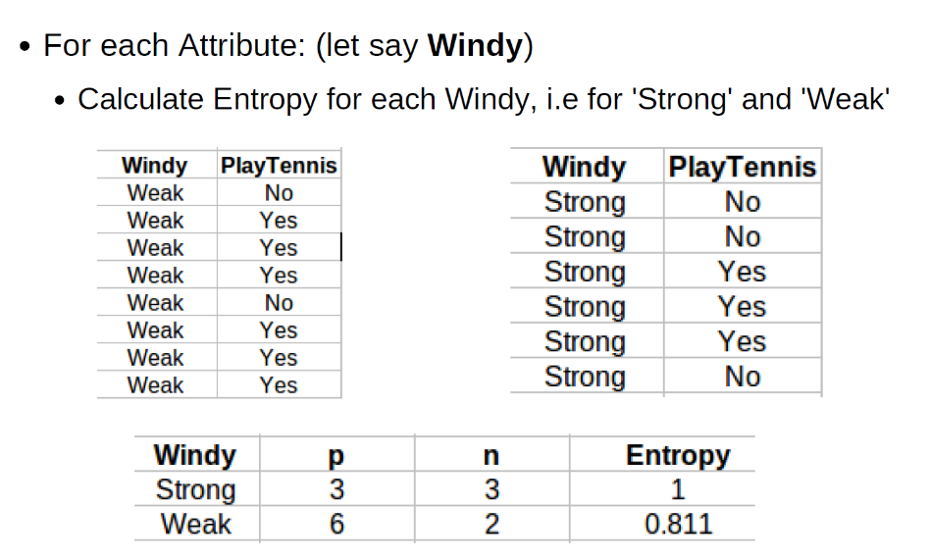
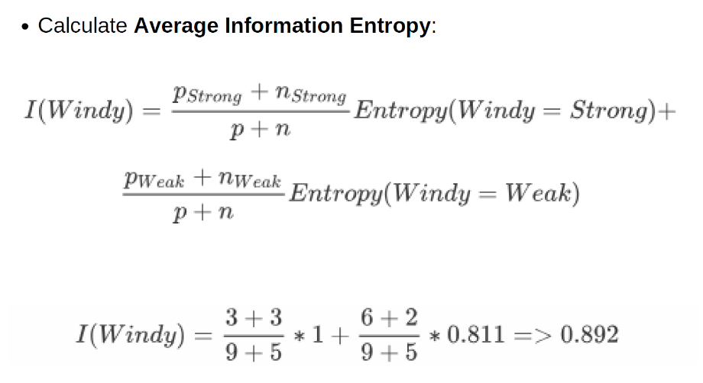
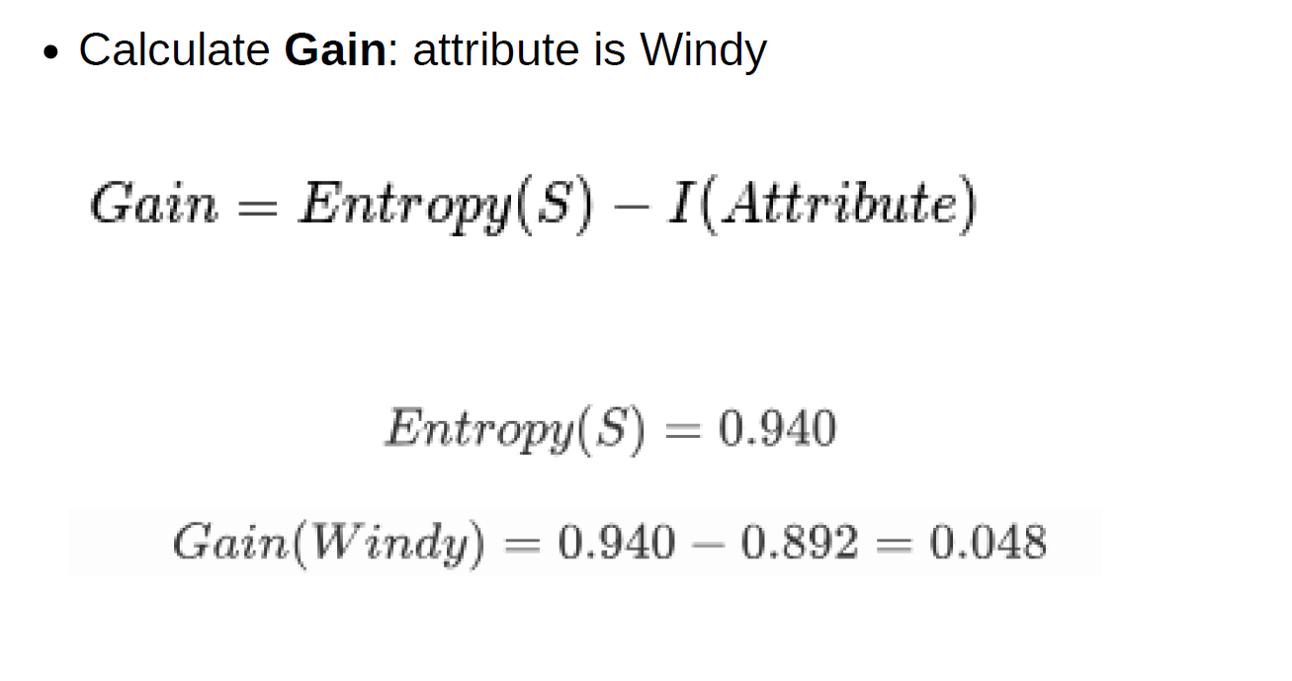

Slide 21
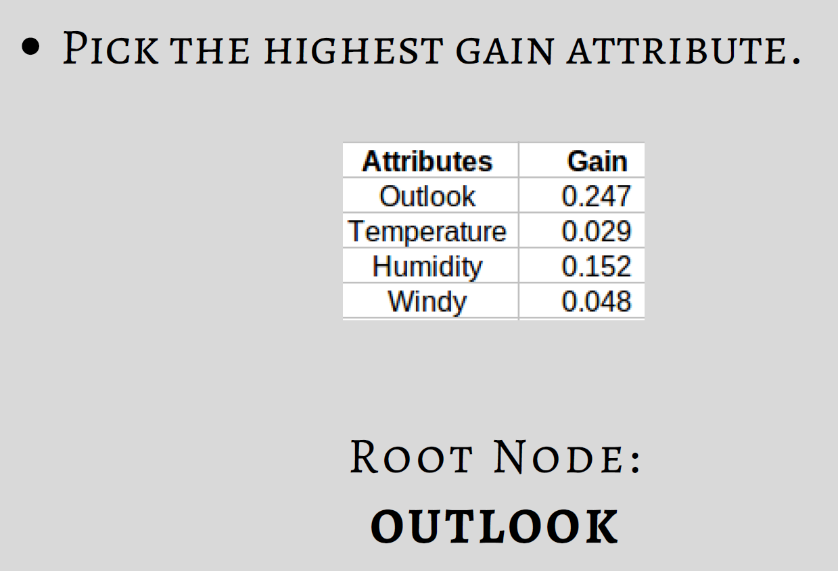

Slide 22
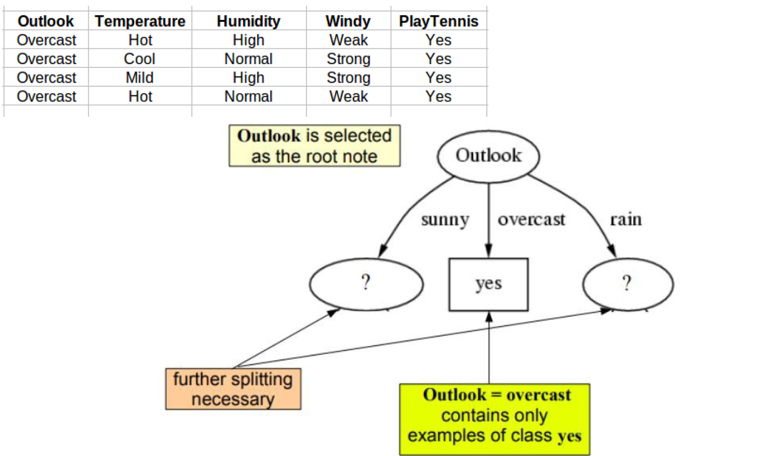

Slide 23
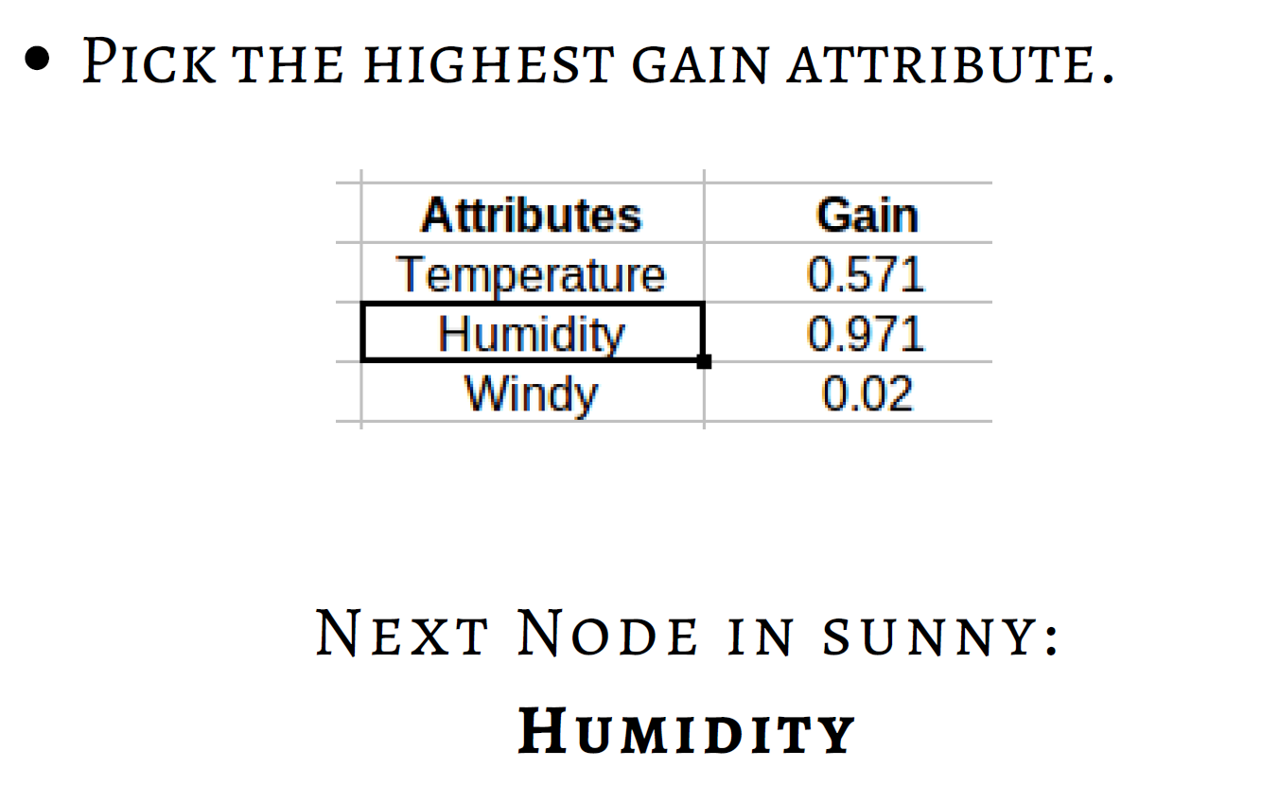
Repeat the same thing for sub-trees till we get the tree.
Calculate Entropy for each Humidity, i.e for 'High' and 'Normal'
Calculate Average Information Entropy: I(Humidity) = 0
Calculate Gain: Gain = 0.971

Slide 24
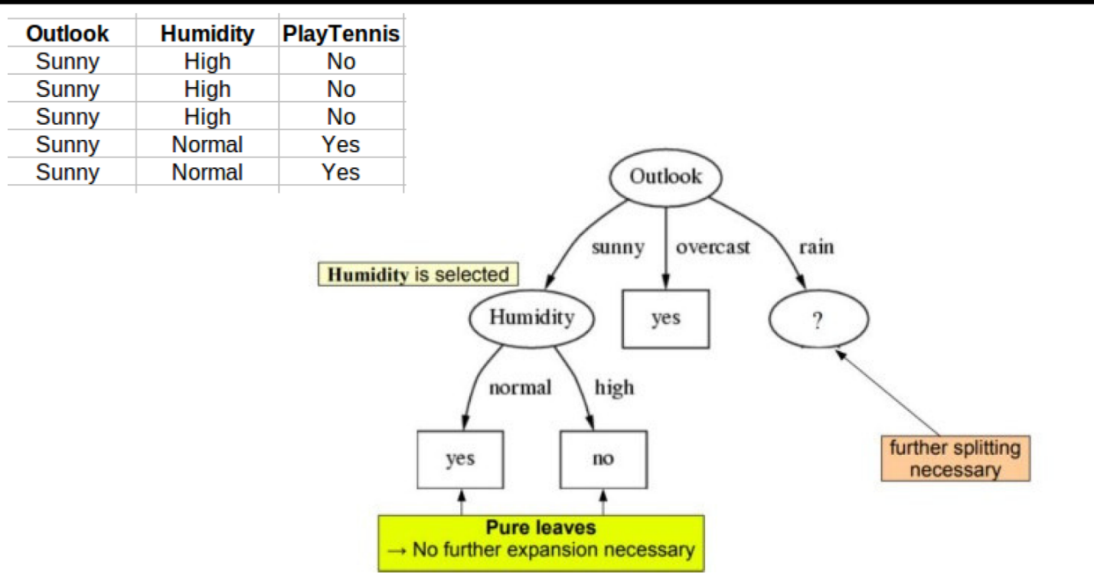

Slide 25
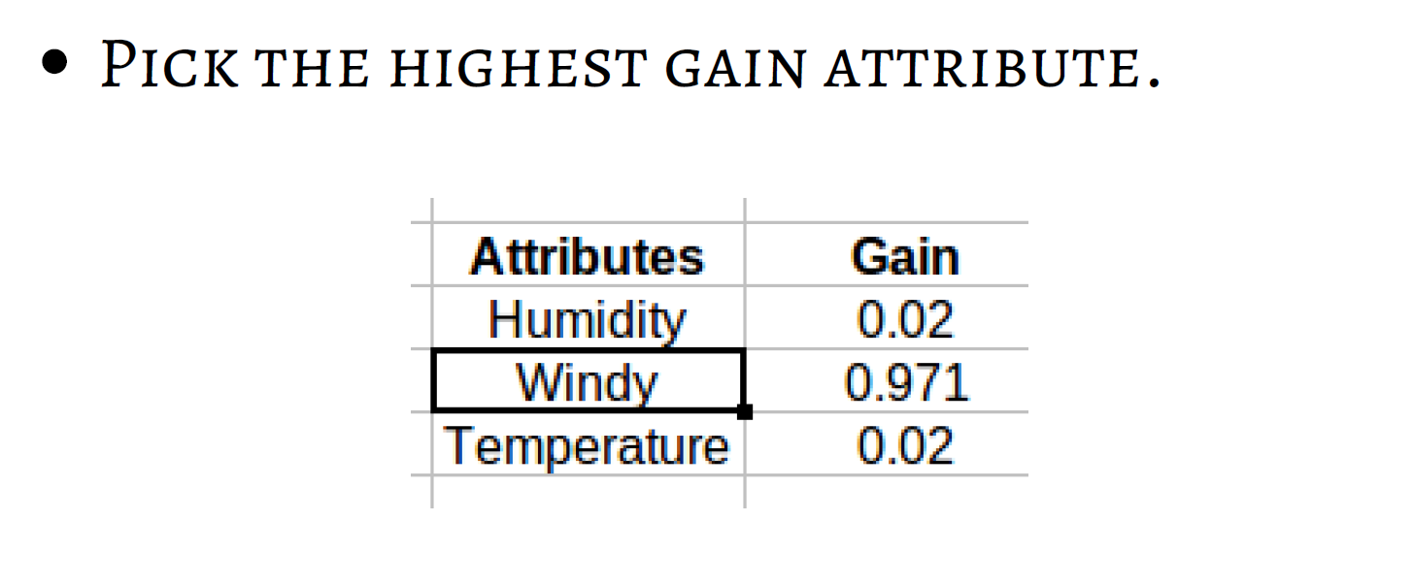
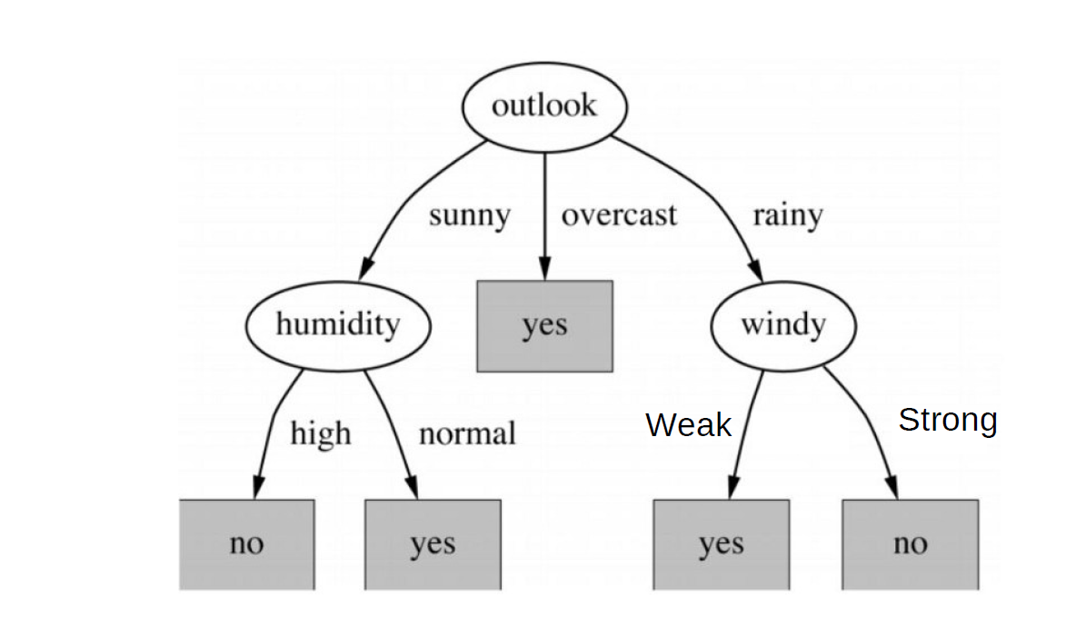
Repeat the same thing for sub-trees till we get the tree.
Calculate Entropy for each windy,
Calculate Average Information Entropy:
Calculate Gain: Gain .

Slide 26
06
Code

Slide 27
Data set
salaries.csv - Google Drive

Slide 28
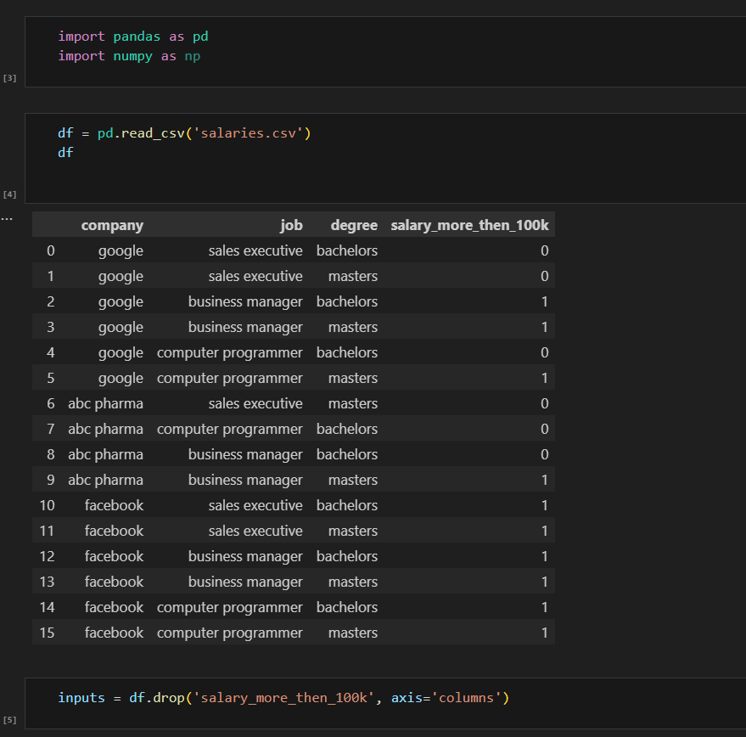
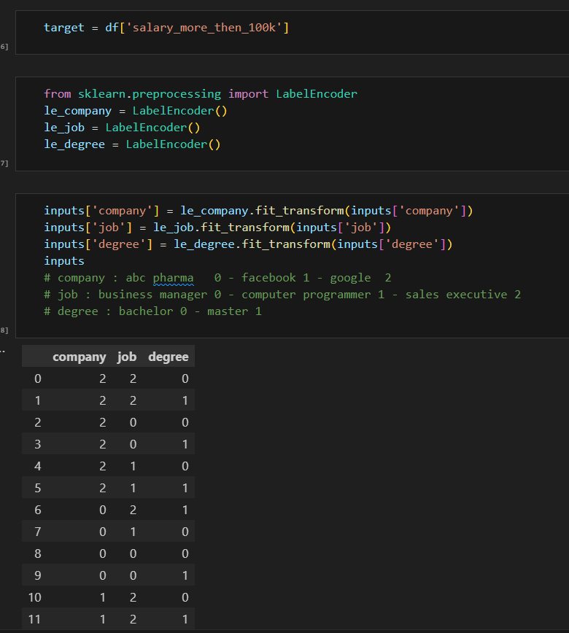

Slide 29
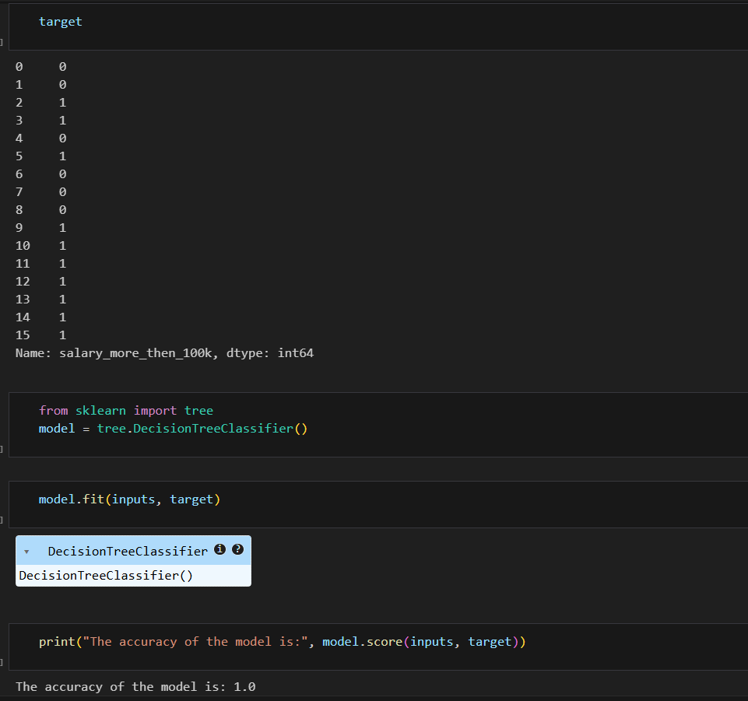
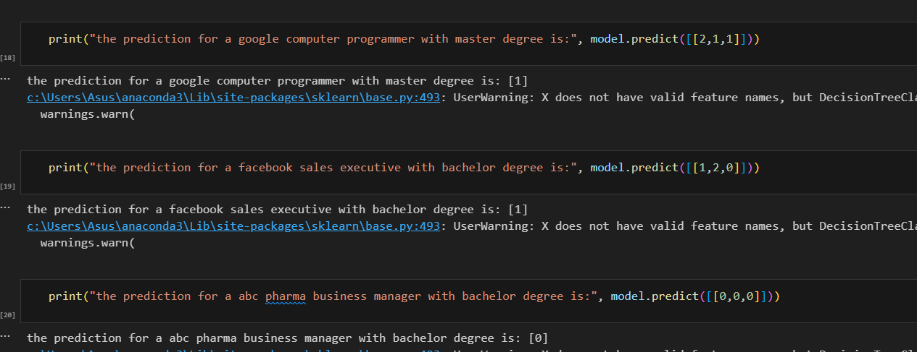

Slide 30
07
Q & A

Slide 31
What is the primary function of a decision tree in machine learning? A. Predict continuous time series B. Cluster unlabeled data C. Predict categorical or numerical outcomes D. Optimize neural network layers Answer: C
What does the root node in a decision tree represent? A. A final classification result B. A question with no answer C. The entire dataset and the first split decision D. The purest node in the tree Answer: C
Which metric is often used to measure impurity in decision trees? A. Variance B. Accuracy C. Gini Impurity or Entropy D. F1 Score Answer: C

Slide 32
4. What is a ‘leaf node’ in a decision tree? A. A node that asks further questions B. A node containing mixed classes C. A node with a single data point D. A node that represents the final classification Answer: D
5. Which metric is based on the concept of 'surprise' or information theory? A. Gini Impurity B. Variance C. Entropy D. RMSE Answer: C
6.What does Information Gain measure in a decision tree? A. How much faster a model runs B. Reduction in impurity after a split C. Number of branches in the tree D. How accurate the tree is Answer: B
7.Which feature of decision trees makes them suitable for stakeholder presentations? A. Low training time B. High prediction accuracy C. Visual interpretability D. High dimensionality tolerance Answer: C
8.When building a regression tree, what is the output at a leaf node? A. The mode of the training labels B. A randomly chosen class C. The average of training values at that node D. The maximum label Answer: C

Slide 33
9.What kind of preprocessing do decision trees typically require? A. Feature normalization B. One-hot encoding of labels C. None or minimal preprocessing D. Dimensionality reduction Answer: C
10.Which ensemble methods are built on decision trees? A. Linear Regression and Lasso B. Neural Networks and CNNs C. Random Forests and Gradient Boosted Trees D. K-Means and DBSCAN Answer: C
Essay:
Compare and contrast Gini Impurity and Entropy as measures of impurity in decision trees. Discuss their mathematical definitions, computational efficiency, and the implications each has on the structure and depth of the resulting tree. Use examples to support your explanation."

